Slide 1


Introduction To Artificial Intelligence
Constraint Satisfaction Problems约束满足问题
王进
成都大学信息科学与工程学院

Slide 2

Constraint Satisfaction Problems约束满足问题
N variables N变量
domain D 值域D
Constraints约束
x₂
x₁
States状态
goal test目标测试
successor function后继函数
partial assignment 部分分配结果
complete; satisfies constraints 满足约束的完备分配
assign an unassigned variable 分配一个未分配变量
Notes:
What is a csp? guess
coloring problem; why does this make sense as problem? silly but good representation for real world problems, e.g. scheduling tasks that need resources – can’t run 2 tasks at the same time if they need the same resource
CSPs as a search problem?

Slide 3


What is Search For?
Assumptions about the world: a single agent, deterministic actions, fully observed state, discrete state space 单一代理、确定的行为空间、状态完全可观测、离散状态空间
Planning: sequences of actions 规划：动作序列
The path to the goal is the important thing 目的是规划一条到目标的路径
Paths have various costs, depths 路径代价不同，深度不同
Heuristics give problem-specific guidance 启发通常提供问题相关的导引
Identification: assignments to variables辨识：变量分配
The goal itself is important, not the path 相比路径，目标更重要
CSPs are specialized for identification problems 约束满足问题主要用于描述辨识问题
Notes:
Step back – these are search problems, so we can now take a look at different problems we can use search for
Before we had planning;
Ninja robot knows where the gem is, but not how to get there
Identification; detective robot wants to know where the gem is – the goal is important, not the path; what is the depth?

Slide 4


Constraint Satisfaction Problems
Standard search problems标准搜索问题中:
State is a “black box”: arbitrary data structure 状态是黑盒子，可以是任意数据结构
Goal test can be any function over states 目标测试可以是状态的任意函数
Successor function can also be anything 转换函数可以是任意形式
Constraint satisfaction problems(CSPs)约束满足问题:
A special subset of search problems 搜索问题的特例
State is defined by variables X_{i} with values from a domain D (sometimes D depends on i) 状态定义为变量X_{i，}值域为D，有时候D取决于i
Goal test is a set of constraints specifying allowable combinations of values for subsets of variables 目标测试通过一组约束条件来表示，对变量X_{i} 的值进行约束
Notes:
Before: states were nodes, no structure, just a set, they could be anything
Goal test – like a judge; just makes decisions; you don’t know how;
Now: Goal test has structure, it ‘s more like a manual describing a set of constraints that have to hold true

Slide 5
CSP Examples
Notes:
I want you to practice formalizing real problems as search/csp problems

Slide 6


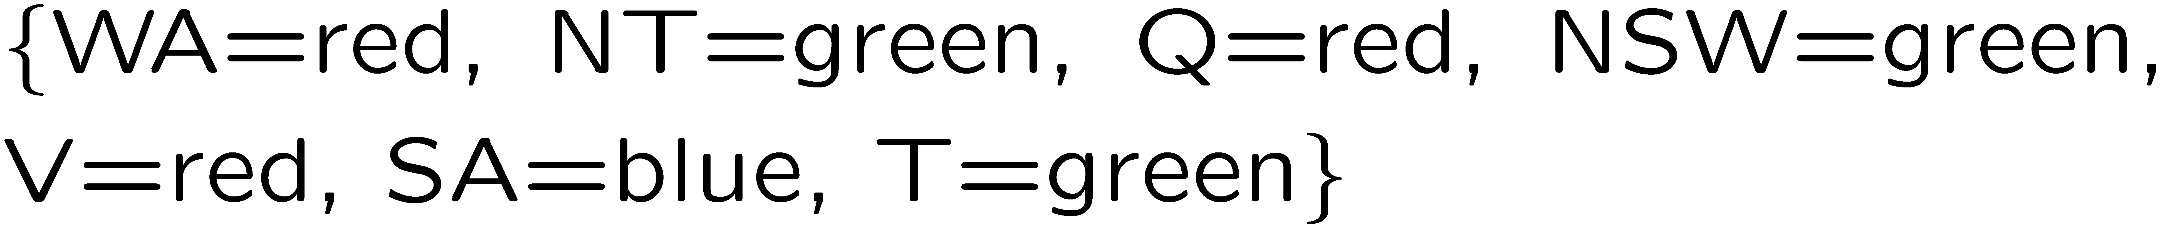
Example: Map Coloring地图着色
Variables:
Domains:
Constraints: adjacent regions must have different colors 相邻区域颜色不能相同
Solutions are assignments satisfying all constraints, e.g.: 解是满足所有约束条件的颜色分配方案
Implicit隐式表达:
Explicit显示表示:
Notes:
How do you specify constraints in code/math? Implicit vs explicit. What might be explicit?

Slide 7
Constraint Graphs约束图

Slide 8
Constraint Graphs约束图
Binary CSP: each constraint relates (at most) two variables 二元约束满足问题即每个约束条件最多涉及两个变量
Binary constraint graph: nodes are variables, arcs show constraints 二元约束图中，节点代表变量，边代表约束
General-purpose CSP algorithms use the graph structure to speed up search. E.g., Tasmania is an independent sub-problem! 通用CSP算法可以利用图结构加速搜索，例如Tasmania是一个独立子问题
Notes:
Demo:
Run constraint.jar or constraint.exe, load the 5 queens problem.
Demo is just showing the n-queens applet as illustration of constraint graph, but later in lecture we’ll interact with the applet.
aispace.org will have the latest version

Slide 9


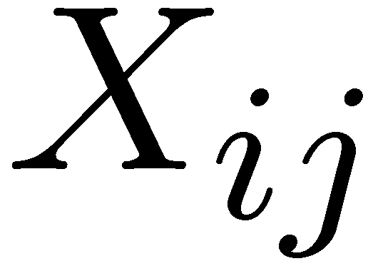

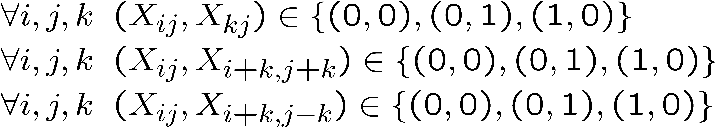
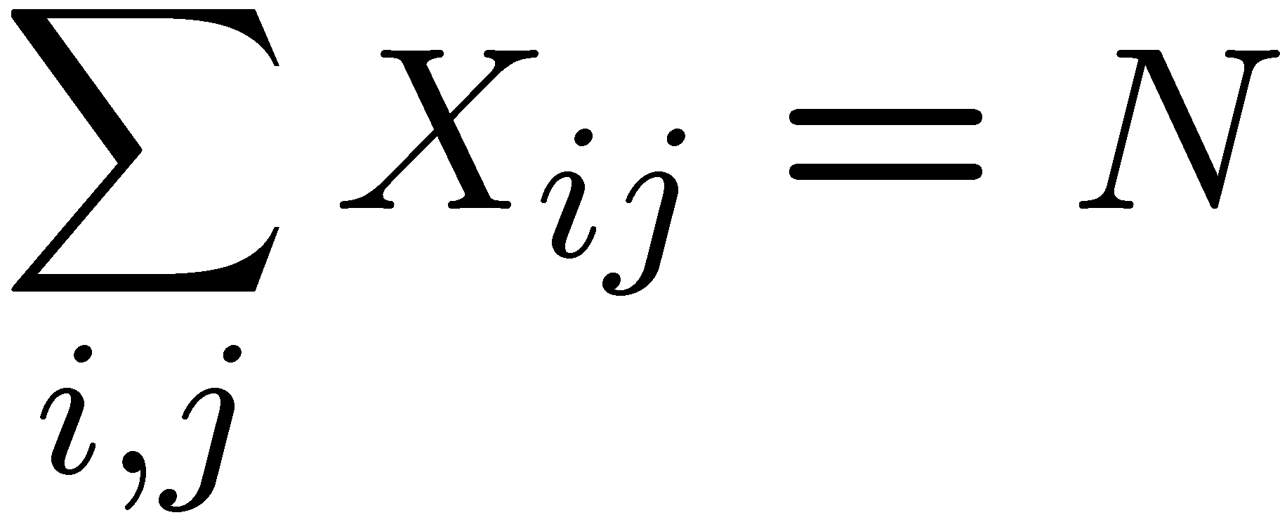
Example: N-Queens 案例：N皇后
Formulation 1: 第一种描述
Variables:
Domains:
Constraints
Notes:
Are these constraints enough? No, there should be N queens there.

Slide 10







Example: N-Queens
Formulation 2:第二种描述
Variables变量:
Domains域:
Constraints约束:
Implicit隐式:
Explicit显式:

Slide 11
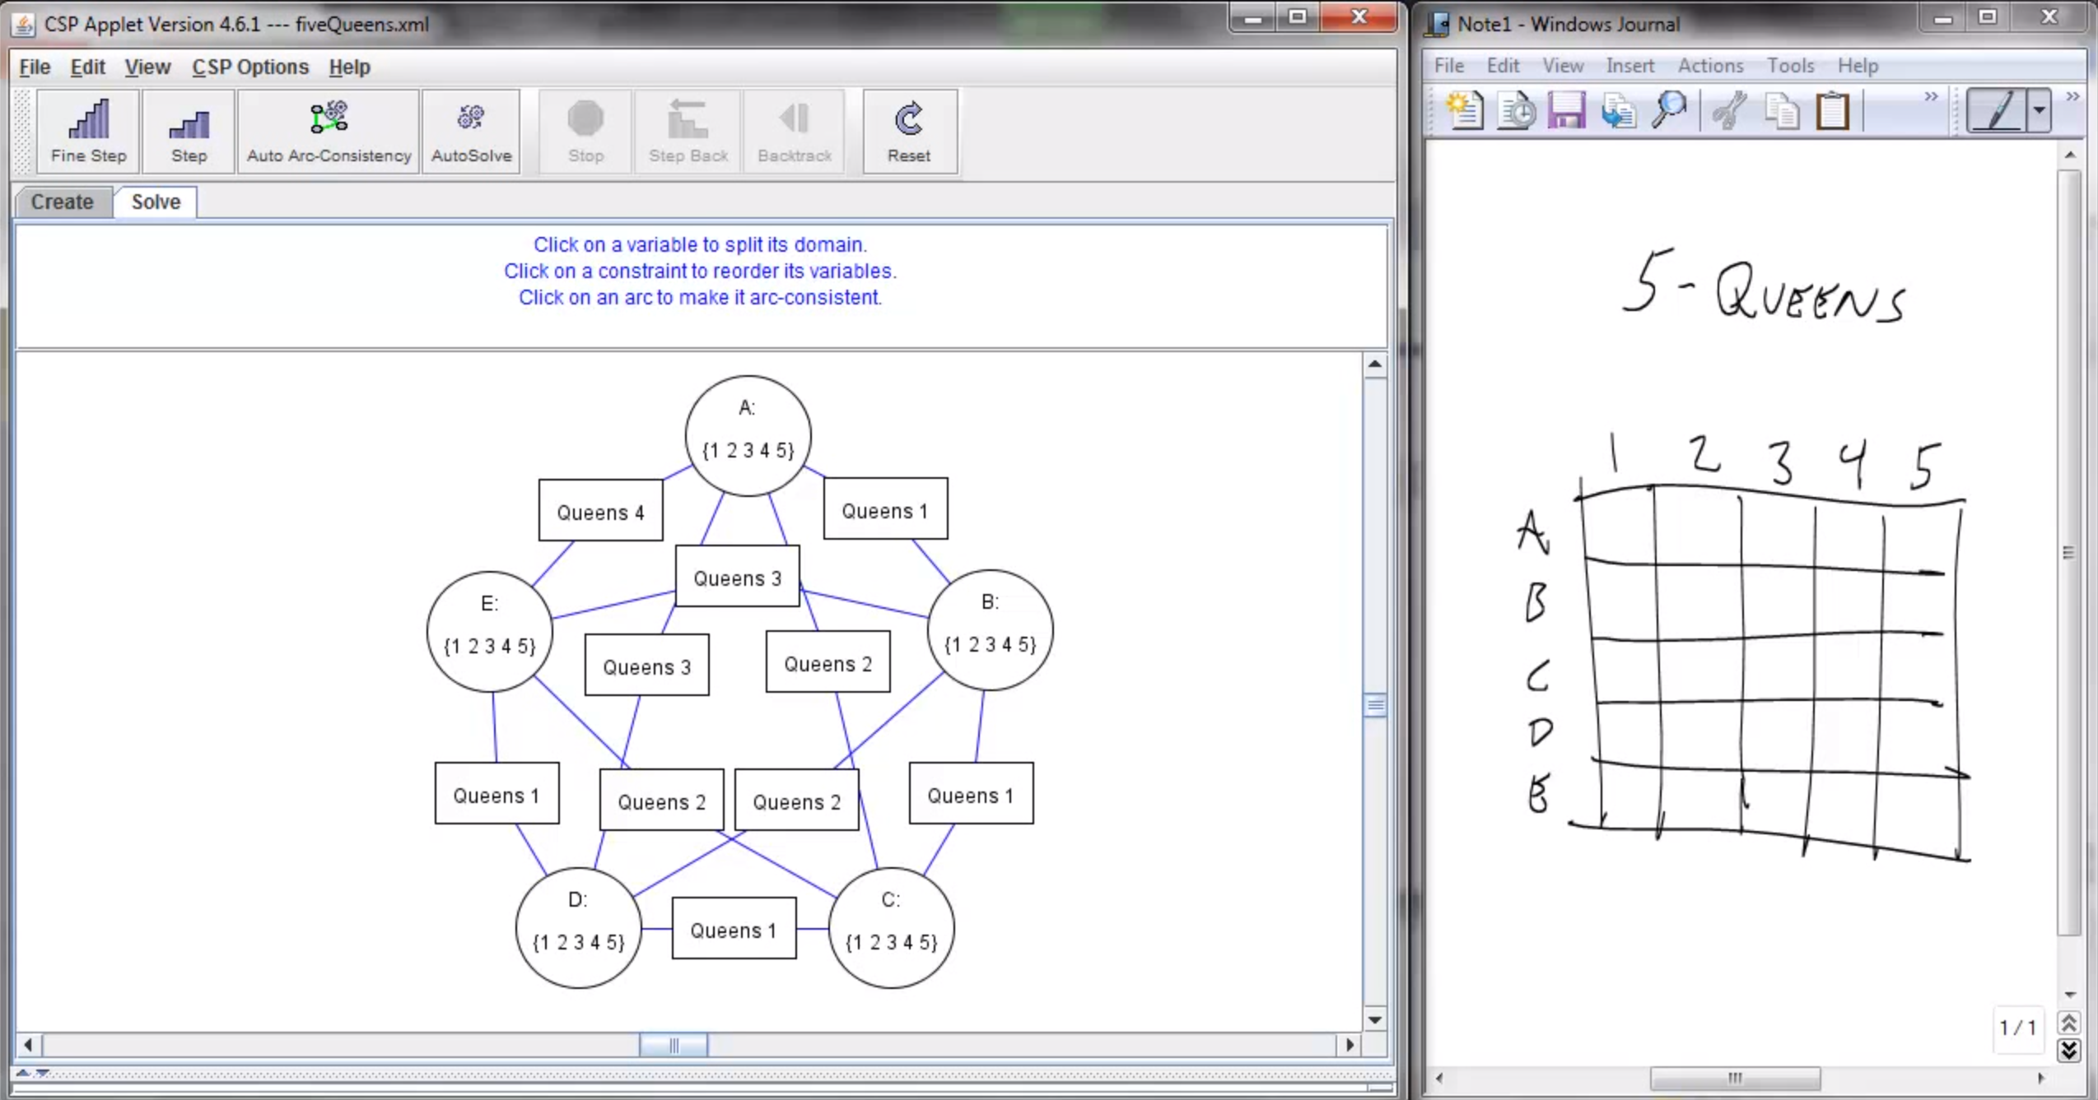
Screenshot of Demo N-Queens
Notes:
Note: the n-queens demo is used later as a demo; at this stage in lecture just the above is shown and talked about without engaging in any interaction with the applet.

Slide 12


Example: Cryptarithmetic
X₁
Variables:
Domains:
Constraints:
Notes:
0=7, R=4, W=6, U=2, T=8, F=1; 867 + 867 = 1734

Slide 13
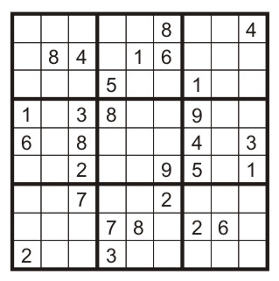
Example: Sudoku 案例：数独游戏
Variables: 变量
Each (open) square 空白方格
Domains: 值域
{1,2,…,9}
Constraints: 约束
9-way alldiff for each column 每列满足 9元不同值约束
9-way alldiff for each row每行满足 9元不同值约束
9-way alldiff for each region每3X3区域满足 9元不同值约束
(or can have a bunch of pairwise inequality constraints亦可通过多个二元不等式约束描述)

Slide 14
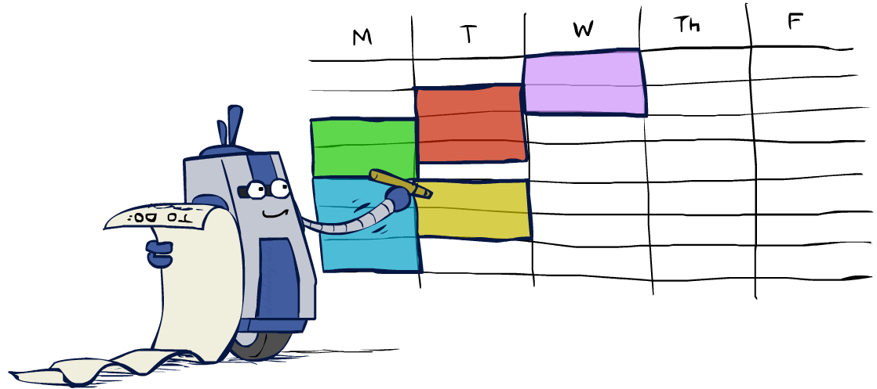
Real-World CSPs现实中的约束满足问题
Assignment problems: e.g., who teaches what class 分配问题：教师-课程
Timetabling problems: e.g., which class is offered when and where? 排课表
Hardware configuration 硬件配置
Transportation scheduling 交通调度
Factory scheduling车间调度
Circuit layout电路排版
Fault diagnosis故障诊断
… lots more!
Many real-world problems involve real-valued variables…

Slide 15
Recap 内容回顾
What is search for? 搜索的目的是什么？
Planning & Identification 规划与辨识
Why CSP? 为什么会有CSP？
In some searching cases, state is not “black box” any more.
How to formulate CSP?如何形式化表示CSP

Slide 16

Solving CSPs 约束满足问题求解

Slide 17
Standard Search Formulation标准搜索描述
States defined by the values assigned so far (partial assignments) 状态定义为已分配的值
Initial state: the empty assignment, {} 初始状态为空
Successor function: assign a value to an unassigned variable 转换函数是给某未分配变量分配值
Goal test: the current assignment is complete and satisfies all constraints 目标测试：当前分配已完成，且满足所有约束
We’ll start with the straightforward, naïve approach, then improve it 接下来先直观方法入手，逐渐改善

Slide 18
Search Methods
What would BFS do?
{}
{WA=g}
{WA=r}
…
{NT=g}
…
[Demo: coloring -- dfs]
Notes:
Where is the goal? If BFS were a person, this is what would keep it up at night.
Demo:

Slide 19
Search Methods
What would DFS do?
{}
{WA=g}
{WA=r}
…
{NT=g}
…
{WA=g,NT=r}
{WA=g,NT=b}
{WA=g,SA=r}
{WA=g,SA=b}
…
{WA=g,NS=g}
[Demo: coloring -- dfs]

Slide 20
Search Methods
What would BFS do?宽度优先搜索
What would DFS do?深度优先搜索
What problems does naïve search have? 这些搜索方法的问题是？
[Demo: coloring -- dfs]

Slide 21

Backtracking Search回溯搜索

Slide 22
Backtracking Search回溯搜索
Backtracking search is the basic uninformed algorithm for solving CSPs回溯搜素是非启发算法解决约束满足问题
Idea 1: One variable at a time 每次处理一个变量
Variable assignments are commutative, so fix ordering -> better branching factor! 变量分配是可互换的，固定的顺序能够带来较下的分支因子
I.e., [WA = red then NT = green] same as [NT = green then WA = red]
Only need to consider assignments to a single variable at each step 每一步只考虑单一变量分配
Idea 2: Check constraints as you go 不断检查约束条件
I.e. consider only values which do not conflict previous assignments 只考虑跟以前分配不冲突的值
Might have to do some computation to check the constraints 检查约束条件期间会涉及到少量计算
“Incremental goal test”相当于是增量目标测试
Depth-first search with these two improvements
is called backtracking search (not the best name) 回溯搜索即是采用上述方法对DFS进行改进
Notes:
Incremental goal test possible because we have the csp structure and the goal test is not a black box

Slide 23
Backtracking Example
[Demo: coloring -- backtracking]

Slide 24
Backtracking Search回溯搜索
Backtracking = DFS + variable-ordering + fail-on-violation 回溯搜索 = DFS + 变量排序 + 违例即失败
What are the choice points? 究竟该怎么排序？
Notes:
We havent talked about the ordering, so lets just assume its some random ordering for now.

Slide 25

Improving Backtracking改进回溯
General-purpose ideas give huge gains in speed 通用算法通常在速度上有巨大的改进空间
Ordering排序:
Which variable should be assigned next? 下次给哪个变量赋值？
In what order should its values be tried? 按照什么顺序为该变量选择值？
Filtering: Can we detect inevitable failure early? 过滤：能否提前探测不可避免的失败？

Slide 26

Filtering过滤
Keep track of domains for unassigned variables and cross off bad options记录未分配变量的值域，删除可能会失败的选项

Slide 27
Filtering: Forward Checking过滤：前向检测
Filtering: Keep track of domains for unassigned variables and cross off bad options过滤：记录未分配变量的值域，删除不良选项
Forward checking: Cross off values that violate a constraint when added to the existing assignment前向检测：删除可能违背约束的值
WA
NT
Q
SA
NSW
V
[Demo: coloring -- forward checking]
Notes:
Demo:
CS188 javascript demos -> source -> exercises -> csps -> CSPs demos -> CSPs demos.html
Settings:
Graph = Simple
Algorithm = Backtracking
Ordering = None
Filtering = Forward Checking

Slide 28
Filtering: Constraint Propagation约束传递
Forward checking propagates information from assigned to unassigned variables, but doesn‘t provide early detection for all failures:前向检测将以分配信息传递给未分配变量，但不能提前检测所有失败
NT and SA cannot both be blue! NT和SA不能同时赋蓝色
Why didn’t we detect this yet? 为什么不能检测这个违例？
Constraint propagation: reason from constraint to constraint原因在于逐个约束传递
NT
Q
WA
SA
NSW
V
Notes:
We’ve already failed, but forward checking does not detect that.

Slide 29

Consistency of A Single Arc单弧相容
An arc X → Y is consistent iff for every x in the tail there is some y in the head which could be assigned without violating a constraint 弧X → Y相容：对于尾部任意变量取值x，如果在头部都能找到相应的值y而不违例。
NT
Q
WA
SA
NSW
V
Delete from the tail!
Notes:
Mnemonic – csp police checks my trunk

Slide 30
Arc Consistency of an Entire CSP弧相容
A simple form of propagation makes sure all arcs are consistent: 简单展示能够确保所有弧相容的传递
Important: If X loses a value, neighbors of X need to be rechecked! 如果X失去一个值，X的邻近需要再被重新检查
Arc consistency detects failure earlier than forward checking 弧相容能够先于前向检测查出失败分配
Can be run as a preprocessor or after each assignment 因此，可以在一次分配之前或之后进行弧相容检测
What’s the downside of enforcing arc consistency? 加强弧相容的不足之处？
NT
Q
WA
SA
NSW
V
Remember: Delete from the tail!
Notes:
remids you of a* - heuristic takes time

Slide 31
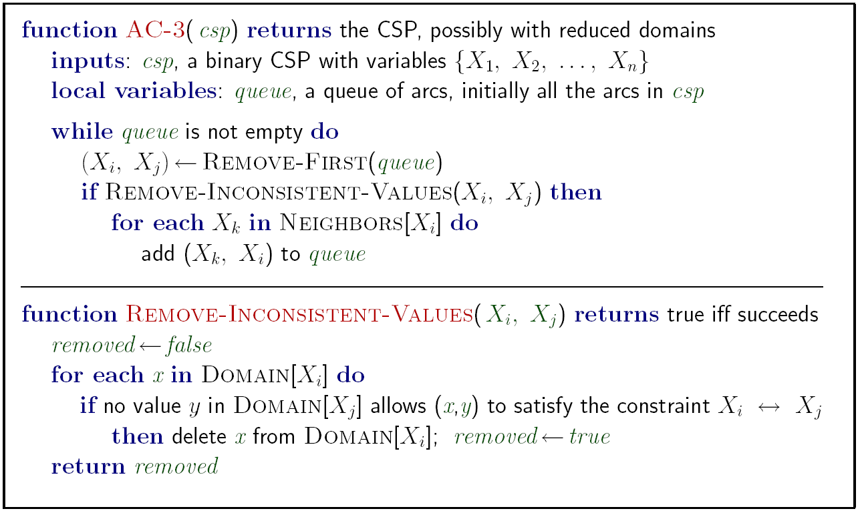
Enforcing Arc Consistency in a CSP
Runtime: O(n²d³), can be reduced to O(n²d²)
… but detecting all possible future problems is NP-hard – why?
Notes:
Auto-consistency (note initially nothing gets deleted/pruned since there are consistent options for all constraints for initial variable domains)
Flashes whenever something needs to be re-checked
n^2*d*d^2

Slide 32


Limitations of Arc Consistency弧相容的局限性
After enforcing arc consistency:加强弧相容后
Can have one solution left
Can have multiple solutions left
Can have no solutions left (and not know it)
Arc consistency still runs inside a backtracking search!
[Demo: coloring -- forward checking]
[Demo: coloring -- arc consistency]

Slide 33

Ordering排序

Slide 34

Ordering: Minimum Remaining Values 排序：最小剩余值
Variable Ordering: Minimum remaining values (MRV):
Choose the variable with the fewest legal left values in its domain选择值域内所剩合法值最少的变量
Why min rather than max? 为什么最小剩余值
Also called “most constrained variable” 最受约束变量
“Fail-fast” ordering 快速失败排序
Notes:
don’t procrastinate

Slide 35

Ordering: Least Constraining Value 排序：最少约束值
Value Ordering: Least Constraining Value值排序：最少约束值排序
Given a choice of variable, choose the least constraining value优先选择最少约束值
I.e., the one that rules out the fewest values in the remaining variables删除约束最少的值
Note that it may take some computation to determine this! (E.g., rerunning filtering) 需要些时间计算
Why least rather than most?
Combining these ordering ideas makes
1000 queens feasible

Slide 36
Summary: CSPs 总结
CSPs are a special kind of search problem:
States are partial assignments状态是部分分配
Goal test defined by constraints
Basic solution: backtracking search
Speed-ups: 性能提升方法
Ordering变量排序
Filtering 过滤

Slide 37
Local Search局部搜索
Tree search keeps unexplored alternatives on the fringe (ensures completeness) 基于树的搜索将未探索解放在队列中，确保完备性
Local search: improve a single option until you can’t make it better (no fringe!)局部搜索逐步改进，直到不能再改进为止，但无队列。
New successor function: local changes 新的后继函数：局部变化
Generally much faster and more memory efficient (but incomplete and suboptimal) 通常比较快而且内存消耗较少，但不完备且只能得到次优解

Slide 38

Hill Climbing 爬山
Simple, general idea: 主要思想
Start wherever从任何地方开始
Repeat: move to the best neighboring state 重复：移动到最好邻近状态
If no neighbors better than current, quit 如果没有邻居比当前状态更好，停止。
What’s bad about this approach? 不足之处？
What’s good about it? 优势在于？
Notes:
Ends up on the hill, looks around, it’s better than all neighbors and declares success
not complete, not optim
Neighbors not obvious

Slide 39
Hill Climbing Diagram爬山

Slide 40
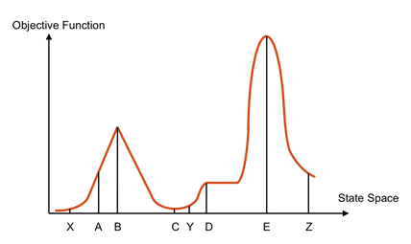
Hill Climbing Quiz 测试
Starting from X, where do you end up ?
Starting from Y, where do you end up ?
Starting from Z, where do you end up ?

Slide 41

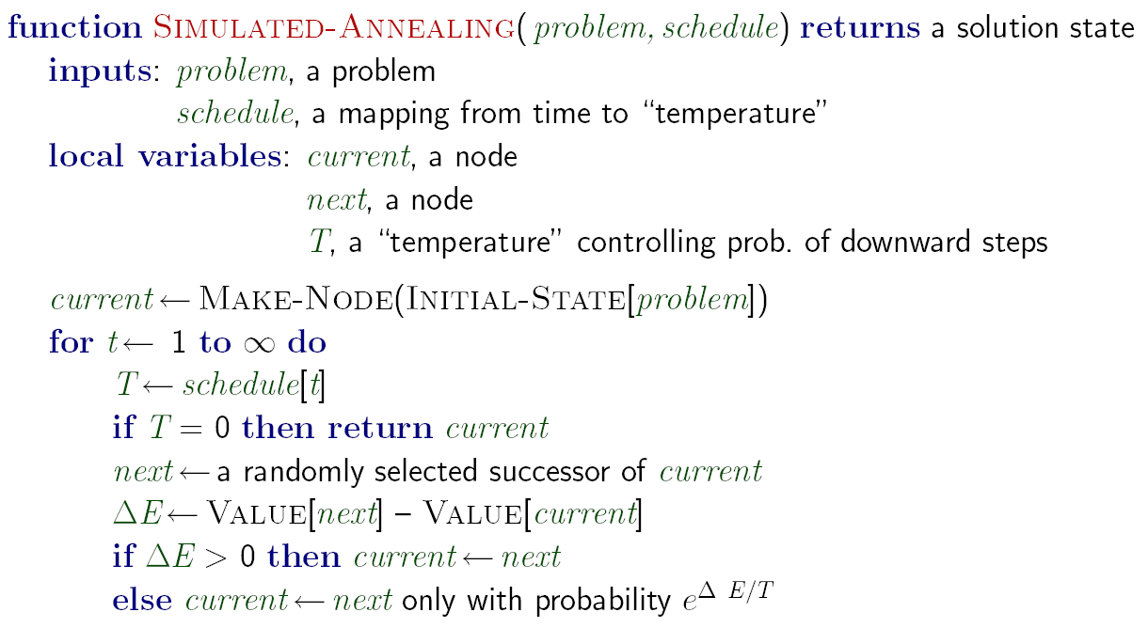
Simulated Annealing模拟退火
Idea: Escape local maxima by allowing downhill moves 通过下山逃出局部最大
But make them rarer as time goes on

Slide 42
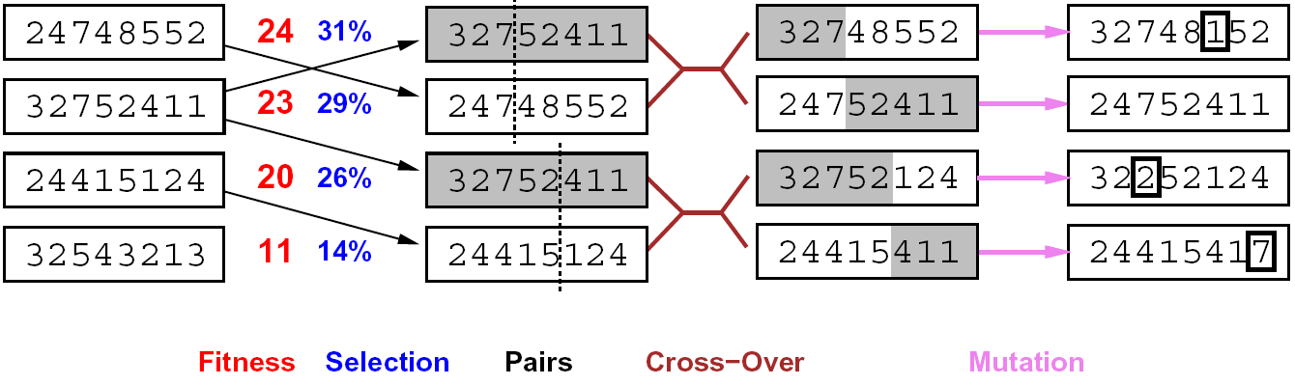

Genetic Algorithms遗传算法
健壮性 选择 对 交叉 变异
Genetic algorithms use a natural selection metaphor 遗传算法使用自然选择的隐喻
Keep best N hypotheses at each step (selection) based on a fitness function 基于健壮性，每次选择最好的N个推断
Also have pairwise crossover operators, with optional mutation to give variety 通过交叉变异增加种类多样性
Possibly the most misunderstood, misapplied (and even maligned) technique around

Slide 43
Homework
Reading Textbook 6.1, 6.3
习题6.2、6.5
Deadline: 23:59,next Friday.

